Slide 1





NEW ORAL ANTICOAGULANTS (NOAC) AND FITNESS TO FLY
René Maire
Severin Muff
Jan Steffel
Cardiological Expert of FOCA
Cardiological and Aviation Medicine Practice, Maennedorf, Switzerland
Chief Medical Officer
Federal Office for Civil Aviation (FOCA), Switzerland
Consultant, Electrophysiology and Cardiac Devices
Department of Cardiology, University Hospital Zurich, Switzerland
Symposium 2014 AMABEL

Slide 2


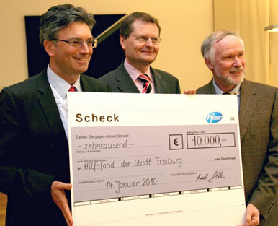

Disclosures: no conflicts of interest

Slide 3
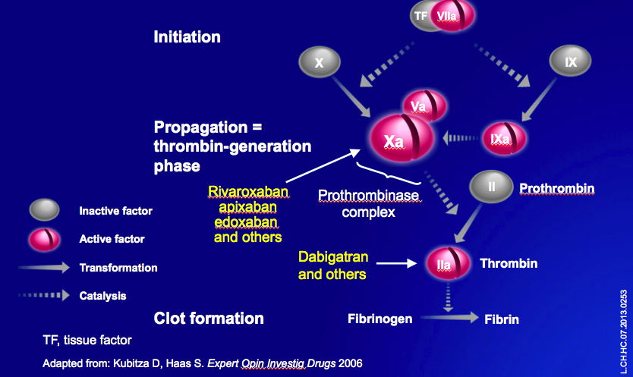
NEW ORAL ANTICOAGULANTS (NOAC) AND FITNESS TO FLY
Introduction
NOAC and EASA until 11/13
Scientific basis
Use of NOAC
Swiss experience
NOAC and EASA now
Conclusions
Symposium 2014 AMABEL

Slide 4
NEW ORAL ANTICOAGULANTS (NOAC) AND FITNESS TO FLY
Introduction
NOAC and EASA until 11/13
Scientific basis
Use of NOAC
Swiss experience
NOAC and EASA now
Conclusions
Symposium 2014 AMABEL

Slide 5

INTRODUCTION
The assessment of fitness to fly is based on risk evaluation ...

Slide 6
INTRODUCTION
Case 1:
75 years old pilot without any major medical problem.
Case 2:
75 years old pilot with known coronary artery disease with previous PCI and stenting of the LAD; positive family history for cardiovascular diseases.
Case 3
35 years old pilot with history of aortic valve replacement with mechanical valve prosthesis, being under well-controlled anticoagulation (warfarin).
Which is the risk of sudden incapacitation in these pilots?

Slide 7

INTRODUCTION
Risks:
Case 2 > Case 1 > Case 3
(75 yrs CAD) (75 yrs) (AVR)
Fitness to fly according to JAR-FCL-Medical-Requirements:
- Case 1 and 2 are fit to fly
- Case 3 is denied (because of anticoagulation)
Valvular surgery
(1) Applicants with implanted mechanical valves shall be assessed as unfit.

Slide 8
INTRODUCTION
The JAR-FCL-Medical-Requirements did not accept anticoagulaton therapy for pilots.
We and other could show that there is a subset of patients/ pilots who are at low risk of thromboembolism and bleeding, and in these cases the assessment of fitness to fly - for example with OML/OSL restriction - is justified.
The EASA-Medical-Requirements accept anticoagulaton therapy for pilots under certain conditions.

Slide 9
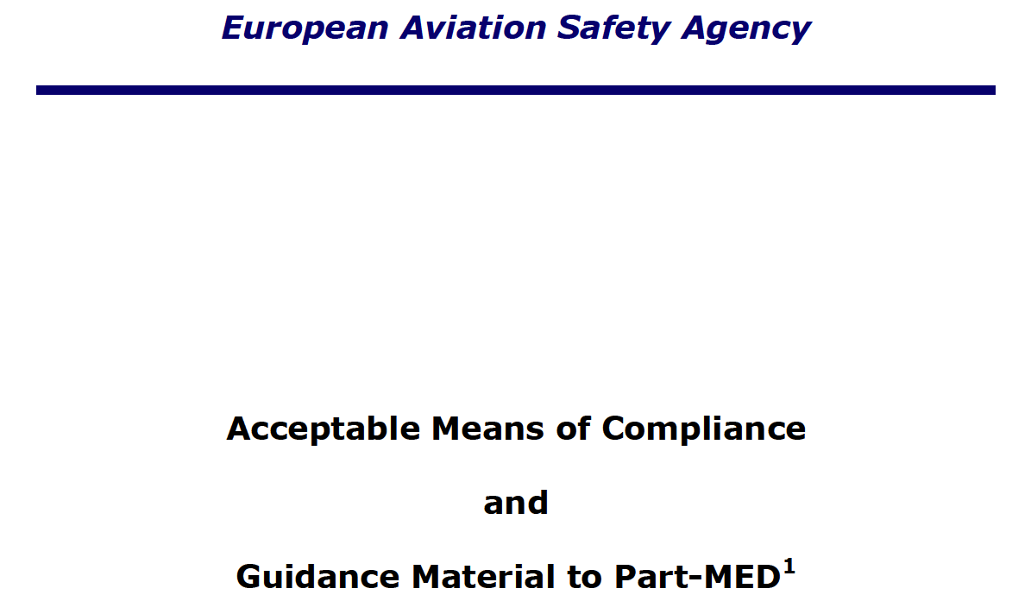

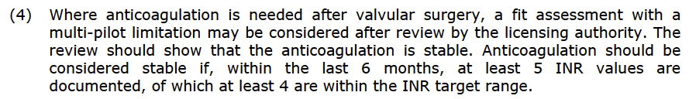
...

Slide 10
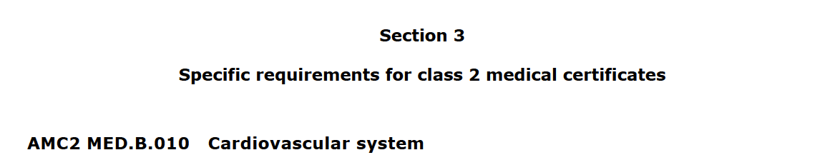
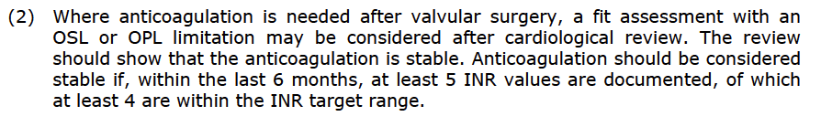
...

Slide 11
NEW ORAL ANTICOAGULANTS (NOAC) AND FITNESS TO FLY
Introduction
NOAC and EASA until 11/13
Scientific basis
Use of NOAC
Swiss experience
NOAC and EASA now
Conclusions
Symposium 2014 AMABEL

Slide 12
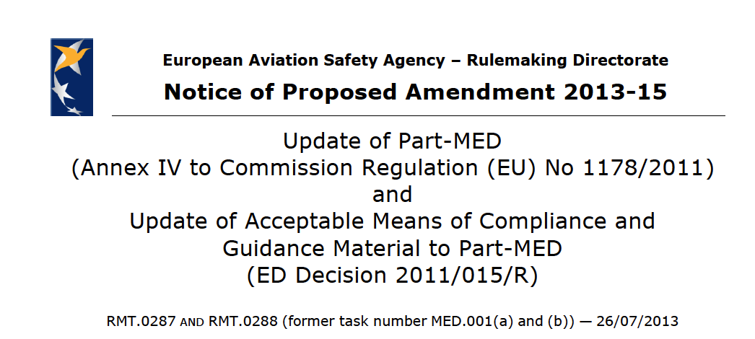
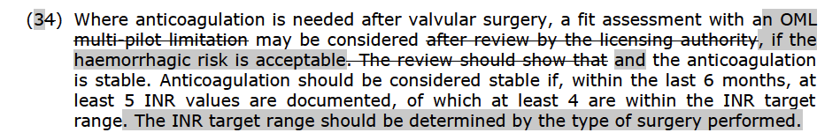
NOAC AND EASA UNTIL 11/2013
NOAC are not mentioned in the actual EASA-Medical-Requirements ...
... and they were ignored in the EASA NPO 2013-15.

Slide 13
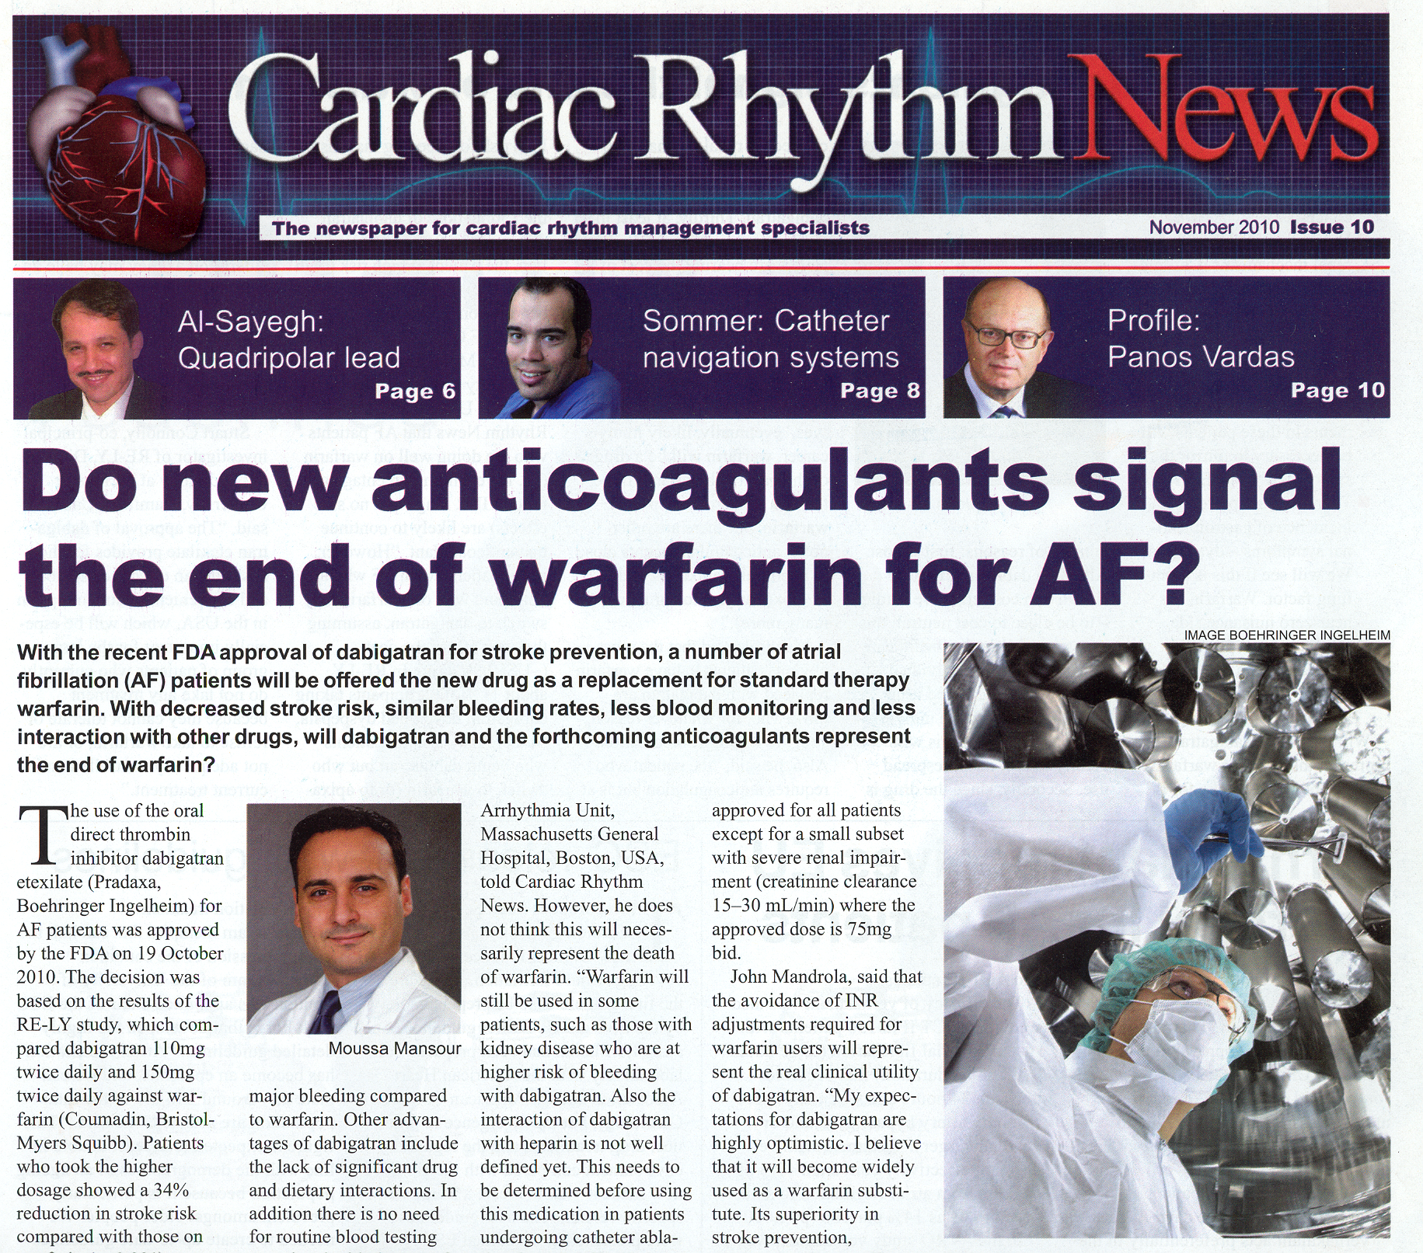

Slide 14


Slide 15
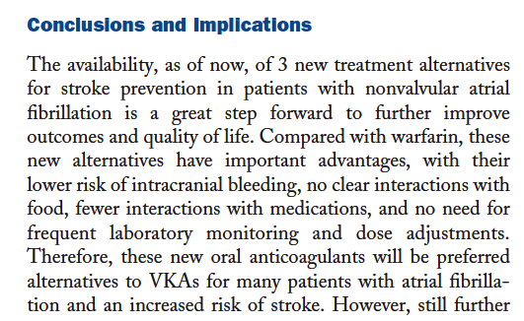
NOAC and EASA until 11/2013
Since 2011 we know:

Slide 16

NOAC and EASA until 11/2013
„Ich möchte nur nochmal betonen, daß NOACs nach den EU Regularien zur Zeit nicht zugelassen sind.“
„I would like to point out once more that NOACs are not accepted according to the actual EU regulations.“

Slide 17
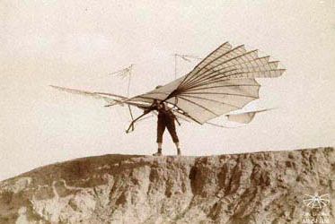
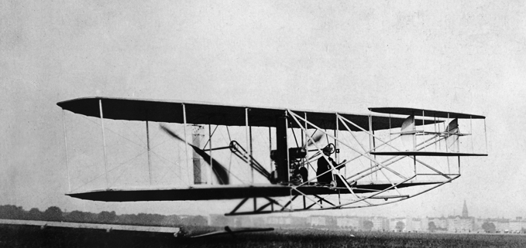

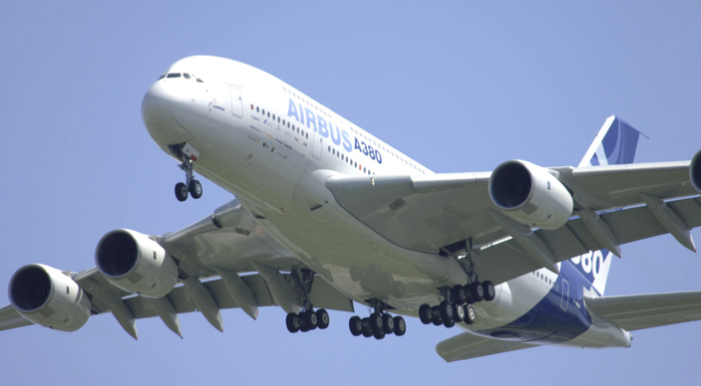
But time goes on ...
... also in the medication field!

Slide 18
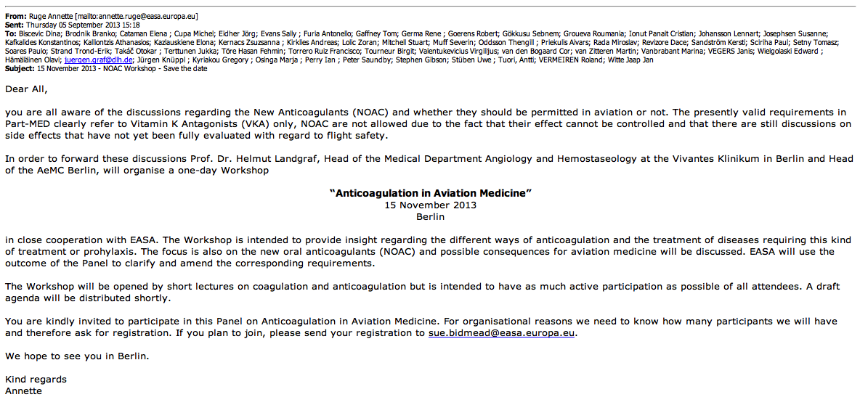
NOAC AND EASA until 11/2013
... but then a turn around occured

Slide 19

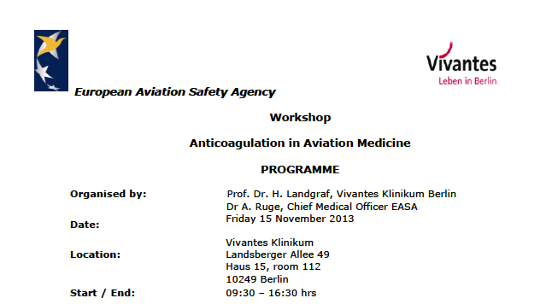
Workshop - Berlin - 15.11.2013:
Anticoagulation in Aviation Medicine
NOAC and EASA until 11/2013

Slide 20
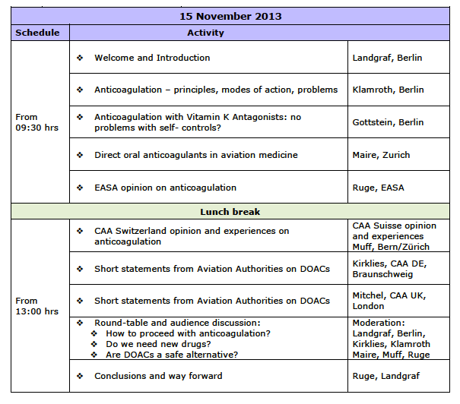
Workshop - Berlin - 15.11.2013:
Anticoagulation in Aviation Medicine
NOAC and EASA until 11/2013

Slide 21
NEW ORAL ANTICOAGULANTS (NOAC) AND FITNESS TO FLY
Introduction
NOAC and EASA until 11/13
Scientific basis
Use of NOAC
Swiss experience
NOAC and EASA now
Conclusions
Symposium 2014 AMABEL

Slide 22
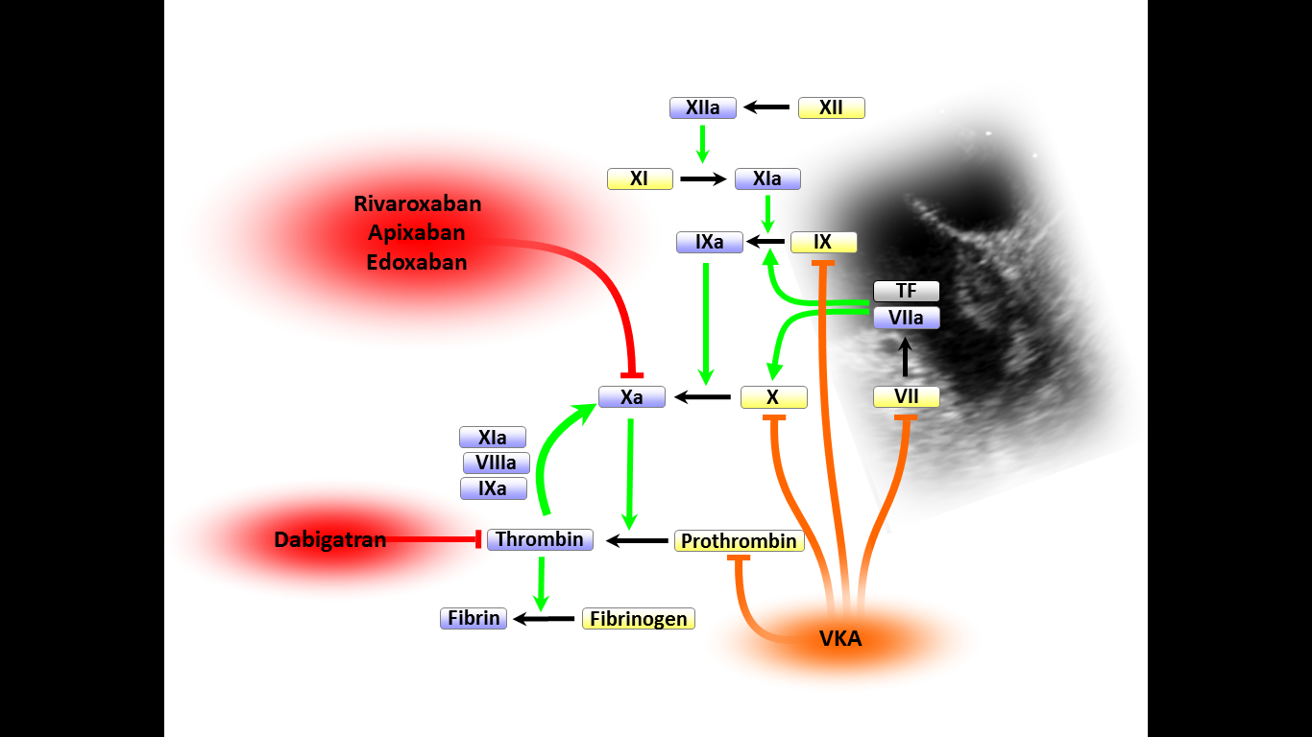
SCIENTIFIC BASIS
Mechanism of action of NOAC

Slide 23
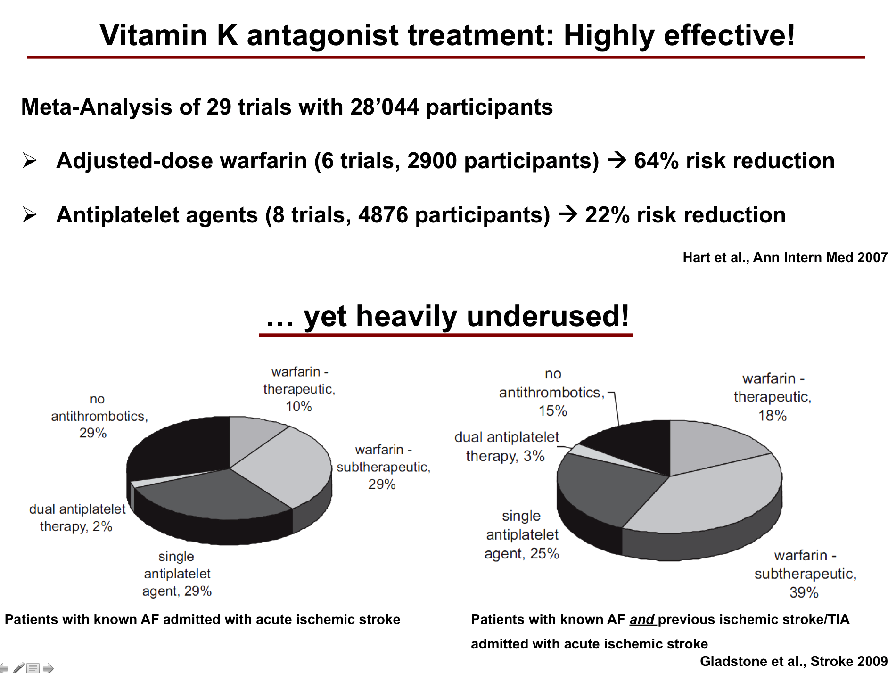
Notes:
23

Slide 24
Drawbacks of VKA treatment
Narrow therapeutic window
  Risk of (recurrent) event if INR ↓
  Bleeding risk, especially if INR ↑
Lifelong INR monitoring
Numerous food- and drug-interactions
Long half-life (cumbersome management, bridging etc.)
Notes:
24

Slide 25
NOAC: Overview
SCIENTIFIC BASIS
 | Atrial fibrillation | DVT prevention | DVT treatment | ACS
Apixaban (Pfizer / BMS) | AVERROES ARISTOTLE | Orthopedic: - ADVANCE 1 - ADVANCE 2 - ADVANCE 3 Medical: - ADOPT Long term: - AMPLIFY-Ext | AMPLIFY | APPRAISE-2
Edoxaban (Daiichi Sankyo) | ENGANGE TIMI 48 | Orthopedic: - STARS E-3 - STARS J-V | HOKUSAI-VTE
Dabigatran etexilate (Boehringer) | Re-LY ReLY-ABLE | Orthopedic: - RE-NOVATE - RE-MODEL - RE-MOBILIZE Long-term: - RE-MEDY | RE-COVER RE-COVER II RE-SONATE
Rivaroxaban (Bayer) | ROCKET-AF | Orthopedic: - RECORD I-IV Medical: - MAGELLAN Long-term: - EINSTEIN-Ext | EINSTEIN-DVT EINSTEIN-PE | ATLAS-TIMI 51

Slide 26
Re-LY – Stroke or Systemic Embolism
RR 0.91
(95% CI: 0.74–1.11)
p<0.001 (NI)
p=0.34 (Sup)
0.05
0.04
RRR
34%
Warfarin
Dabigatran etexilate 110 mg
Dabigatran etexilate 150 mg
0.03
Cumulative hazard rates
0.02
RR 0.66
(95% CI: 0.53–0.82)
p<0.001 (NI)
p<0.001 (Sup)
0.01
0.0
0
0.5
1.0
1.5
2.0
2.5
Years
N Engl J Med 2009;361.
Notes:
26

Slide 27
Re-LY – Intracranial Bleeding
Conolly S, ESC 2009
Notes:
27

Slide 28
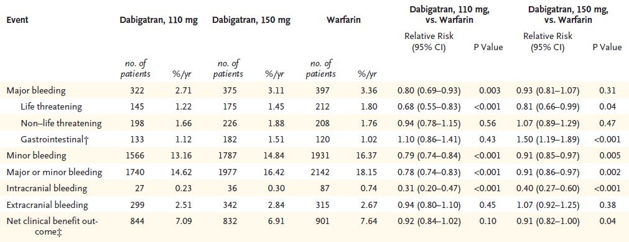
Re-LY – Bleeding events
Conolly et al., NEJM 2009
Notes:
28

Slide 29
ROCKET-AF – Primary efficacy outcome
Stroke or Systemic Embolism
21% event reduction
NNT = ca. 200
Patel et al 10.1056/NEJMoa1009638 2011

Slide 30
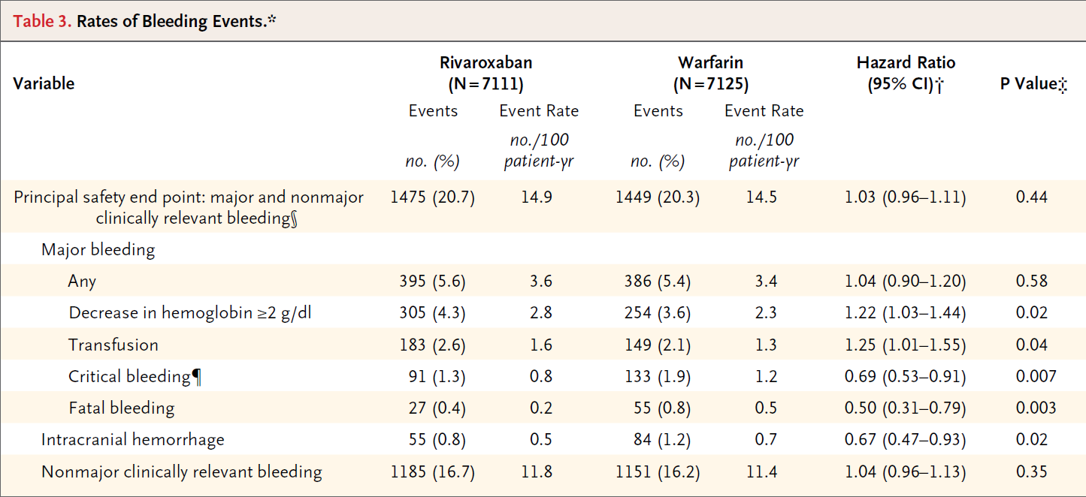
ROCKET-AF – Bleeding events
Gastrointestinal (upper, lower, and rectal) 224 (3.15) 154 (2.16) < 0.001
Patel et al 10.1056/NEJMoa1009638 2011
Notes:
30
30

Slide 31
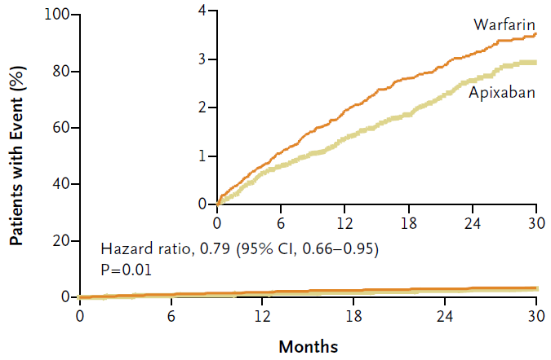
ARISTOTLE – Stroke or systemic embolism
Granger et al., NEJM 2011
Notes:
31

Slide 32
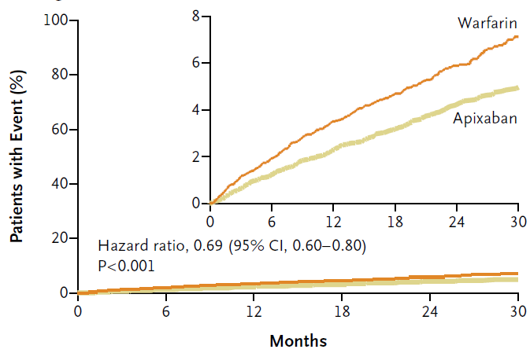
ARISTOTLE – Major bleeding
Granger et al., NEJM 2011
Notes:
32

Slide 33
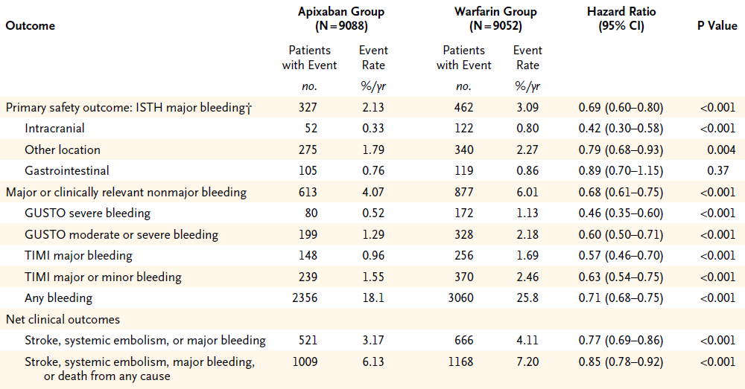
ARISTOTLE – Bleeding events
Granger et al., NEJM 2011
Notes:
33

Slide 34
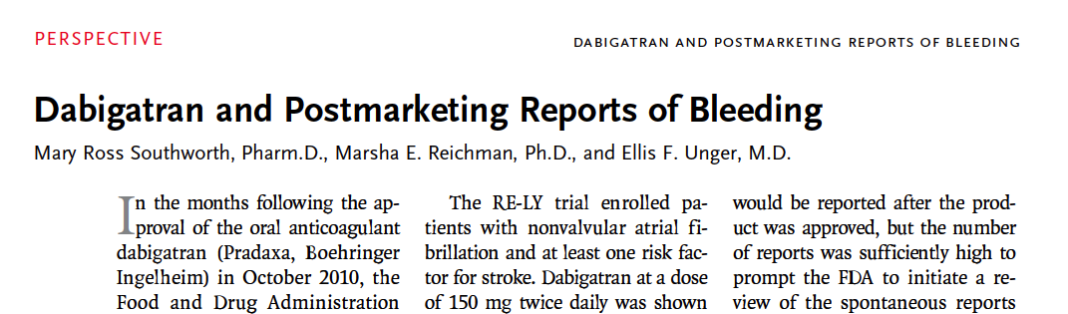


Slide 35
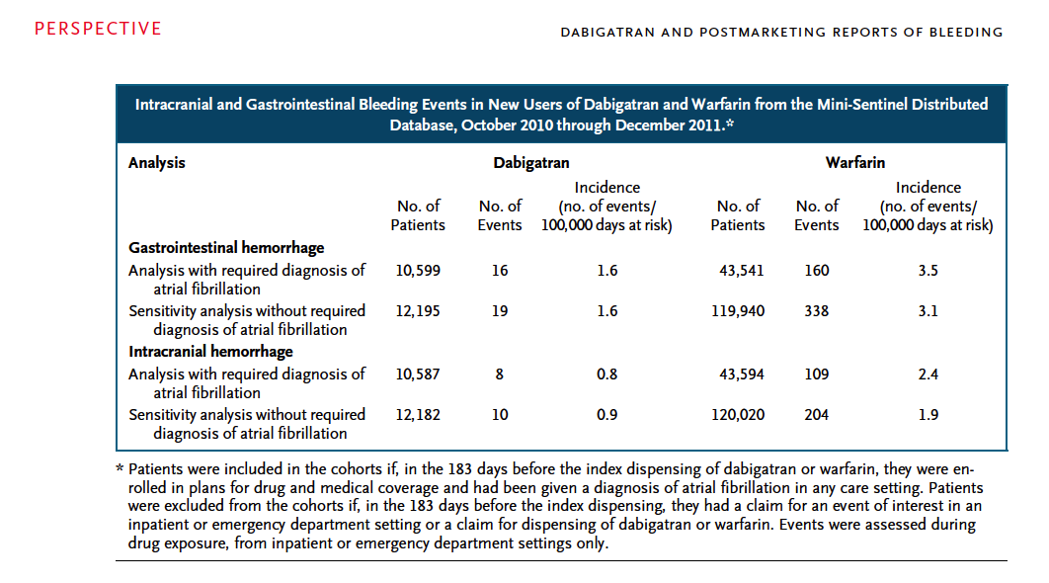

Slide 36
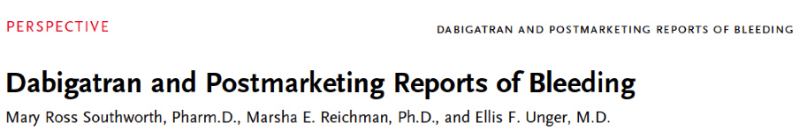
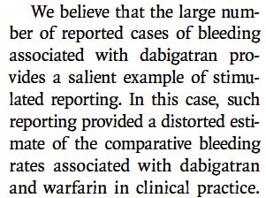
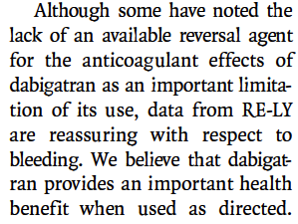

Slide 37
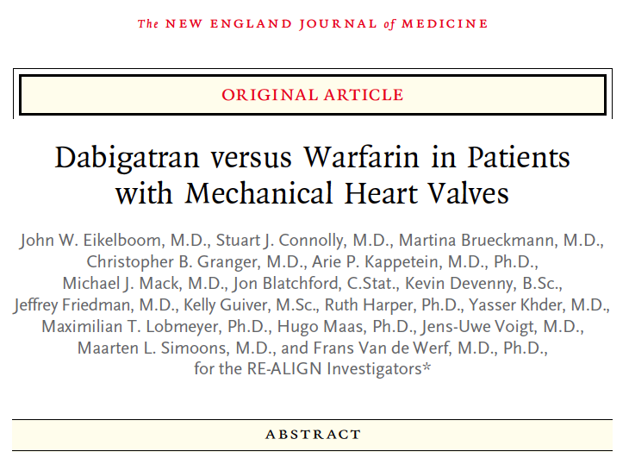

Slide 38
Conclusions
The use of dabigatran in patients with mechanical heart valves was associated with increased rates of thromboembolic and bleeding complications, as compared with warfarin, thus showing no benefit and an excess risk.

Slide 39
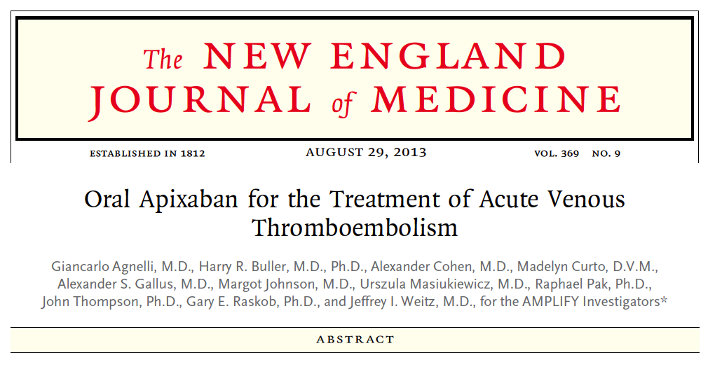

Slide 40
Study Overview
In this multicenter trial, the oral factor Xa inhibitor apixaban was compared with enoxaparin and warfarin for the treatment of acute venous thromboembolism.
Apixaban was noninferior to enoxaparin and warfarin with respect to efficacy and superior with respect to safety.
A fixed-dose regimen of apixaban alone was noninferior to conventional therapy for the treatment of acute venous thromboembolism and was associated with significantly less bleeding.

Slide 41
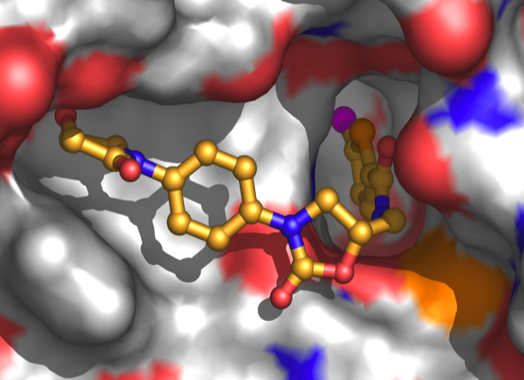
SCIENTIFIC BASIS
The use of NOAC in atrial fibrillation is well established.
In the USA, Dabigatran is on the market since October 2010.
In a meta-analysis including twelve randomized trials comparing NOAC with warfarin in patients with atrial fibrillation, there was a statistically signifikant relative risk reduction of 11% in the incidence of total mortality and cardiovascular mortality. The observed advantage of the newer drugs was consistent for all outcomes, including stroke, systemic embolism and major bleeding. The conclusion of that meta-analysis was: "Taken together, our results suggest that the use of the NOAC not only provide practical advantages over the VKA’s (vitamin K antagonists), but it is also associated with an overall clinical benefit, suggesting their cost-effectiveness”.
NOAC are included in the 2012 guidelines of the European Society of Cardiology (ESC) concerning atrial fibrillation. In these ESC-guidelines, the level of indication for the use of NOAC is defined for the various situations where anticoagulation is demanded; in certain settings, the NOAC are preferred to the vitamine K antagonist.

Slide 42
SCIENTIFIC BASIS
Of course there are several points to be considered when using NOAC.
There might be important interactions with other drugs. Overall, these interactions are less than those known with warfarin, and medical doctors involved in the treatment of patients taking warfarin have learned to consider interactions in daily medical practice.
Another important problem with NOAC is the lack of an antidot. With respect of fitness to fly this does not pose a problem, because it does not touch the risk of sudden incapacitation. It has to be stated that there are neither antidots for other drugs which are commonly used, especially for the platelet antiaggregation drugs like Aspirine, Clopidogrel, Prasugrel etc.

Slide 43
SCIENTIFIC BASIS
Which are the differences between the three NOAC substances?
See movie ...

Slide 45
NEW ORAL ANTICOAGULANTS (NOAC) AND FITNESS TO FLY
Introduction
NOAC and EASA until 11/13
Scientific basis
Use of NOAC
Swiss experience
NOAC and EASA now
Conclusions
Symposium 2014 AMABEL

Slide 46
USE OF NOAC
NOAC in patients with non-valvular atrial fibrillation
The concept works:
Congruent results with 3 novel substances out of 2 classes!
Advantages:
Improved efficiency: less strokes and less systemic embolism
Improved safety: less intracranial and less severe life-threatening hemorrhages
Simpler management (no monitoring, no dose adaptation)
Less interactions (medication, food)
Potential risks or uncertainties:
Quantification of the anticoagulant effect (should be validated)
A specific, rapid effective antidot is not yet available
Caution in special situations (e. g. in renal insufficiency)
Uncertain in special situations like e. g. after acute coronary syndrome, combination with dual platelet antiaggregation therapy
Contraindication in patients with mechanical valve prostheses
Compliance!

Slide 47
USE OF NOAC
Contraindication
Hypersensitivity to the substance
Endocarditis
Clinically significant bleeding
Acute gastrointestinal ulcer or gastrointestinal ulcerative disease
Severe liver disease and liver insufficiency with significant increased risk of bleeding and slight or moderate liver insufficiency in combination with coagulopathy
Severe renal insufficiency: GFR < 30 ml/min
Pregnancy

Slide 48
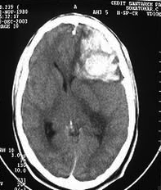

USE OF NOAC
Most important advantages of NOAC in patients with atrial fibrillation
Reduction of severe and intracranial hemorrhages!
Increase of number of patients under correct anticoagulation!

Slide 49
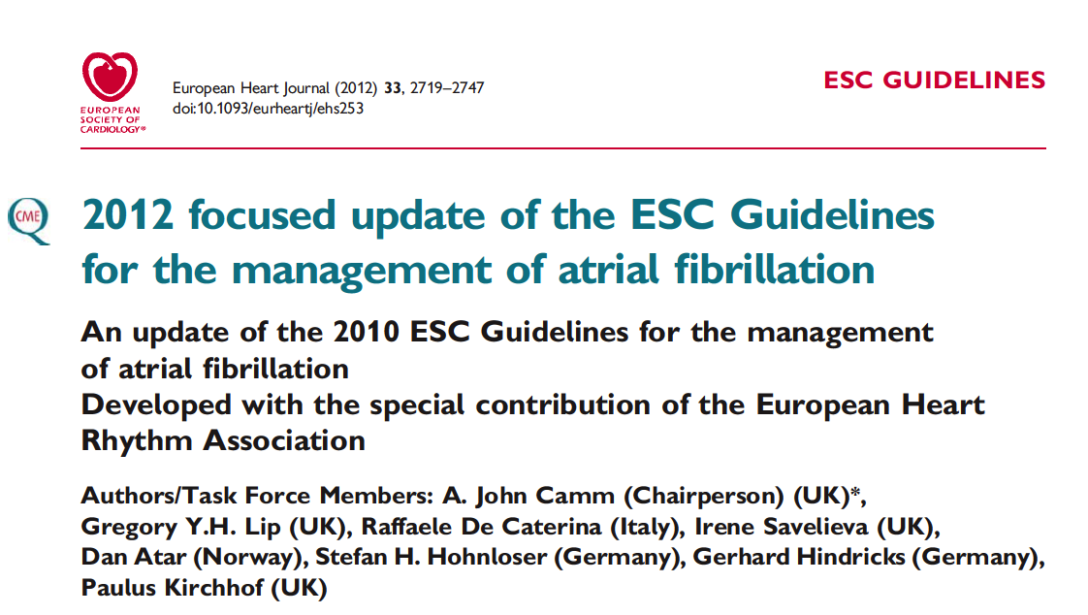
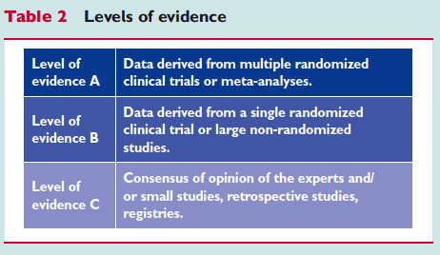
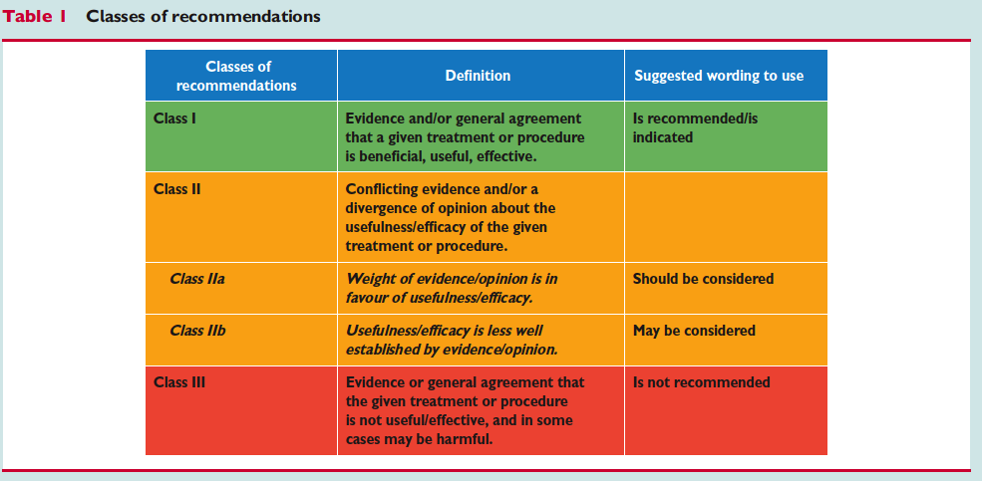

Slide 50
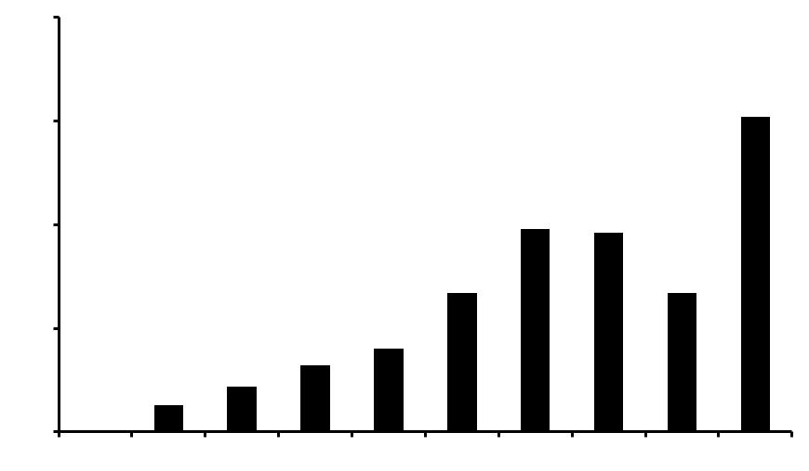
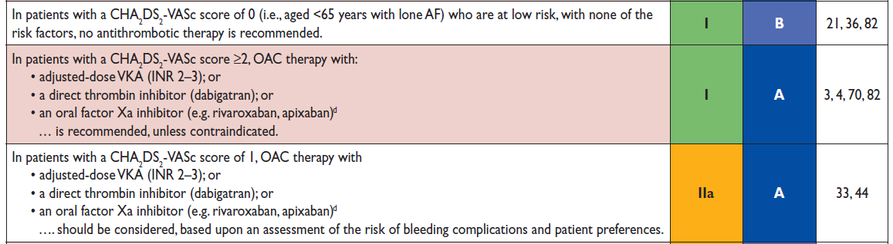
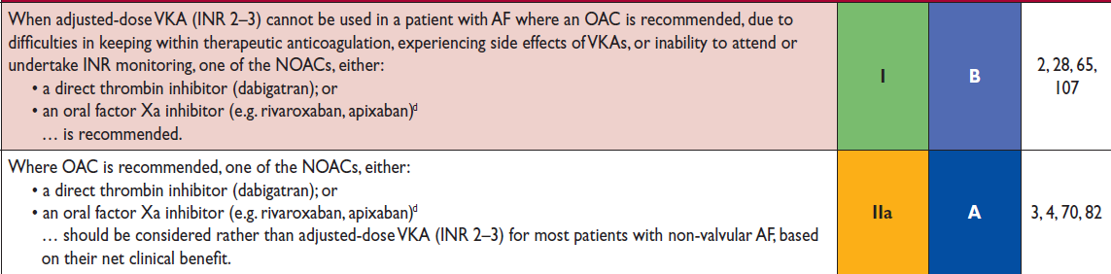
Stroke risk in atrial fibrillation – CHA₂DS₂-VASc score
Risikofaktor Pts.
Herzinsuffizienz 1
Hypertonus 1
Alter ≥ 75 J. 2
Diabetes mellitus 1
St.n. Stroke / TIA 2
Vaskuläre Erkankung 1
Alter 65-74 1
Weibliches Geschlecht 1
20 %
Jährliches Risiko für Schlaganfall
15.2%*
15 %
10 %
9.8%
9.6%
6.7%
6.7%*
5 %
4.0%
3.2%
2.2%
1.3%
0%
CHA₂DS₂-VASc
Score
0 | 1 | 2 | 3 | 4 | 5 | 6 | 7 | 8 | 9
Antikoagulation
Keine
OAK
OAK
Notes:
50

Slide 51
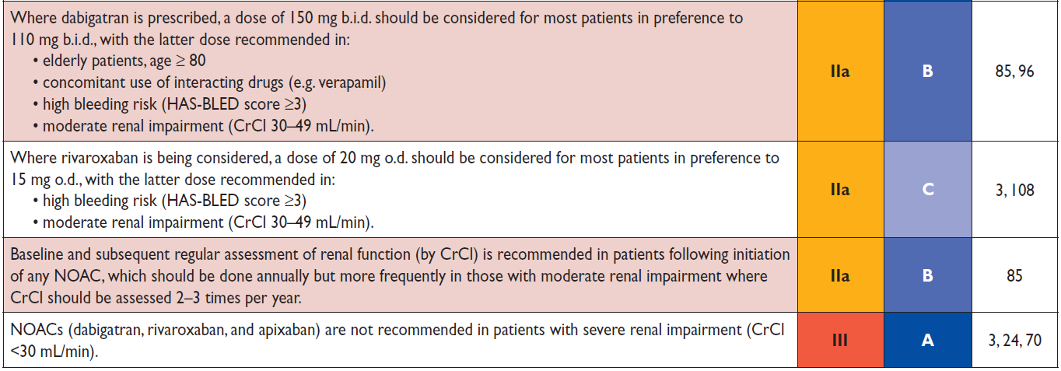
ESC Guidelines 2012
European Heart Journal 2012
Notes:
51

Slide 52
USE OF NOAC
In summary, actually NOAC are used ...
... for prophylaxis of stroke and systemic embolism in atrial fibrillation
... for prophylaxis of thrombosis during or after orthopedic operations
... for prophylaxis and therapy of deep venous thrombosis and pulmonary embolism

Slide 53
NEW ORAL ANTICOAGULANTS (NOAC) AND FITNESS TO FLY
Introduction
NOAC and EASA until 11/13
Scientific basis
Use of NOAC
Swiss experience
NOAC and EASA now
Conclusions
Symposium 2014 AMABEL

Slide 54

SWISS EXPERIENCE
Because the use of NOAC is a reality and because - given the scientific basis - it is unethical to force pilots to use vitamin K antagonists instead of NOAC, we had to find a solution.
Under vitamin K antagonists, fitness to fly is given, if the underlying disease has not a high risk per se, and if a good control of the anticoagulation is proven (wording in the text of Guidance Material to Part-MED: „Anticoagulation should be considered stable if, within the last 6 months, at least 5 INR values are documented, of which at least 4 are within the INR target range“).
Persons who take NOAC do not need laboratory tests to prove an established anticoagulant status. But some interactions with other drugs might occur. Therefore, if an anticoagulation with NOAC has been started, it is reasonable to observe the tolerance of the new drug for a certain time period.
If NOAC are introduced in pilots we require a three month period of stability, proven by a written statement, before a fitness to fly with OML and/or OSL is given.
We have had several such pilot cases since spring 2012, and we have not had any problems.

Slide 55
NEW ORAL ANTICOAGULANTS (NOAC) AND FITNESS TO FLY
Introduction
NOAC and EASA until 11/13
Scientific basis
Use of NOAC
Swiss experience
NOAC and EASA now
Conclusions
Symposium 2014 AMABEL

Slide 56
Workshop - Berlin - 15.11.2013:
Anticoagulation in Aviation Medicine
NOAC and EASA now

Slide 57
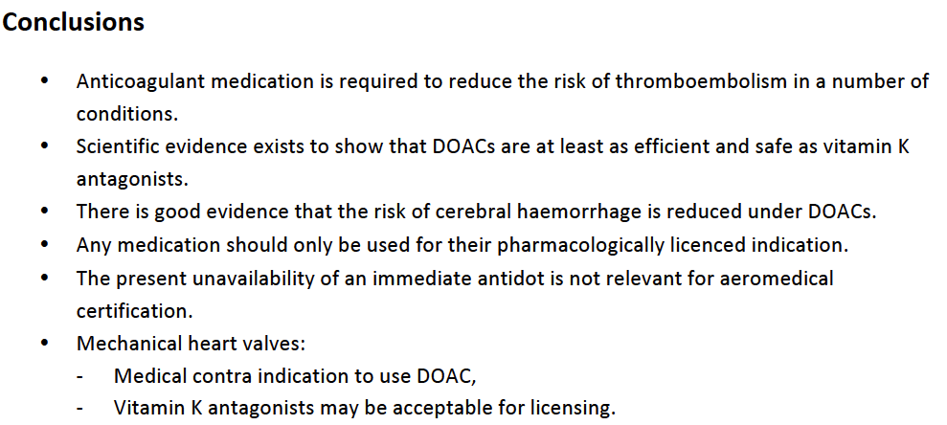
Workshop - Berlin - 15.11.2013:
Anticoagulation in Aviation Medicine
NOAC and EASA now

Slide 58
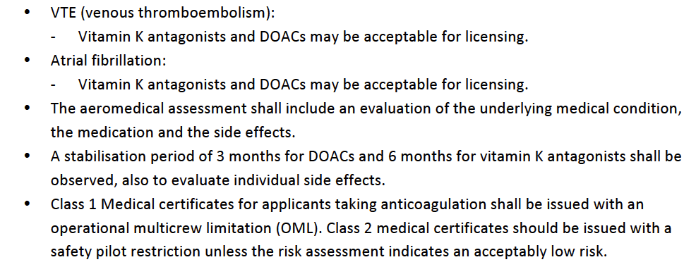
Workshop - Berlin - 15.11.2013:
Anticoagulation in Aviation Medicine
NOAC and EASA now

Slide 59
NEW ORAL ANTICOAGULANTS (NOAC) AND FITNESS TO FLY
Introduction
NOAC and EASA until 11/13
Scientific basis
Use of NOAC
Swiss experience
NOAC and EASA now
Conclusions
Symposium 2014 AMABEL

Slide 60
CONCLUSIONS
The use of NOAC is a reality, it has been approved by FDA and most European medication regulatory bodies, and it can be found in international guidelines, e. g. in those of the ESC (European Society of Cardiology).
Numerous international NOAC studies have proven their improved efficiency and improved safety compared to vitamin K-antagonists.
The use of NOAC can be dangerous if specific considerations are ignored. When using NOAC, indications and contraindications must carefully be respected like with other medication.
There is no reason to withheld the use of NOAC to pilots and to force them to use vitamin K antagonists, this is even unethical.
EASA actually does accept the use of NOAC by pilots as it does accept anticoagulation with vitamin K antagonists by pilots (certain criteria must be fulfilled). The sections of the AMC, where anticoagulation is mentioned, will be corrected.

Slide 61

Thank you for your attention!

